Slide 2
Digital twin of University
Capstone Project Synopsis Presentation
SUBMITTED BY:-
Krrishika Taneja – 500120536- Full stack AI
Devansh Grover – 500119879 – Full stack AI
MENTORED BY:-
Mr. Vishal Lohan
Assistant professor

Slide 3
Abstract
Universities are complex, resource-intensive ecosystems whose information systems run in silos and offer only static, historical dashboards.
This project builds a Digital Twin of a University: a continuously synchronized virtual replica of departments, buildings, classrooms, labs, libraries, hostels, courses, timetables, attendance and energy consumption.
On top of the virtual model it layers predictive analytics, anomaly detection, what-if simulation, resource optimization and a Generative AI assistant.
Administrators, faculty, students and facility managers get one role-based platform to monitor, predict, simulate and optimize campus operations instead of only observing them after the fact.

Slide 4
Introduction
Problem: campus data lives in disconnected systems with no predictive, diagnostic or simulation capability.
• Digital Twin paradigm (Grieves) is proven in manufacturing, smart cities and healthcare; smart-campus twins exist but lack prediction, simulation and optimization layers.
• Proposed solution: a full-stack platform maintaining a live virtual model of the campus, enriched with AI/ML.
• Target beneficiaries:
Administrators — anticipate shortages, test policies before enacting them, receive AI recommendations.
Faculty — classroom availability, timetable state, course and attendance analytics.
Students — predicted library/hostel occupancy, personal attendance and timetable.
Facility managers — energy monitoring, utilization and anomaly response.

Slide 5
Objectives
Build a Digital Twin representation of core university entities with real-time, continuously synchronized state.
Ingest data from university databases/CSV exports and simulated real-time sensor streams (occupancy, energy, environment).
Provide predictive analytics for classroom demand, energy consumption, library/hostel occupancy and transport demand. • Detect anomalies in energy, occupancy and attendance patterns and alert facility managers.
Deliver a what-if simulation engine to evaluate enrollment growth, facility closure and schedule changes.
Recommend classroom, timetable and energy optimizations using constraint satisfaction, LP and genetic algorithms.
Offer a RAG-grounded Generative AI assistant for natural-language querying of the twin.
Ship an interactive role-based dashboard secured with authentication and RBAC.

Slide 6
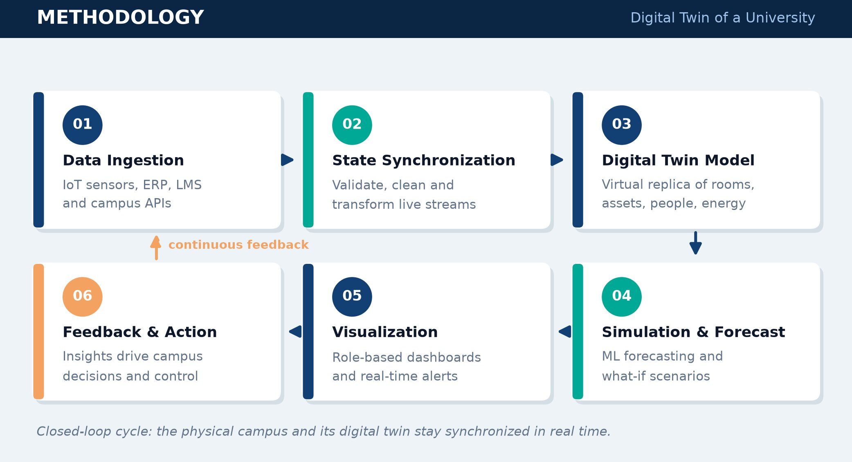
Methodology

Slide 7
Tools and Technologies
Frontend & UI
Next.js
React
TypeScript
Tailwind CSS
Backend & Database
Python
FastAPI
PostgreSQL
Cloud & Security
• Docker
• AWS S3
• Redis
• JWT
• OAuth 2.0
• RBAC
• API Gateway
AI/ML & GenAI
• Python
• Random Forest
• RAG
• Local LLM

Slide 8
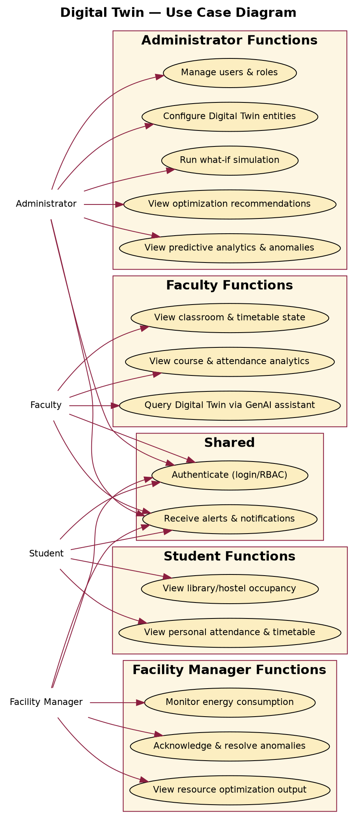
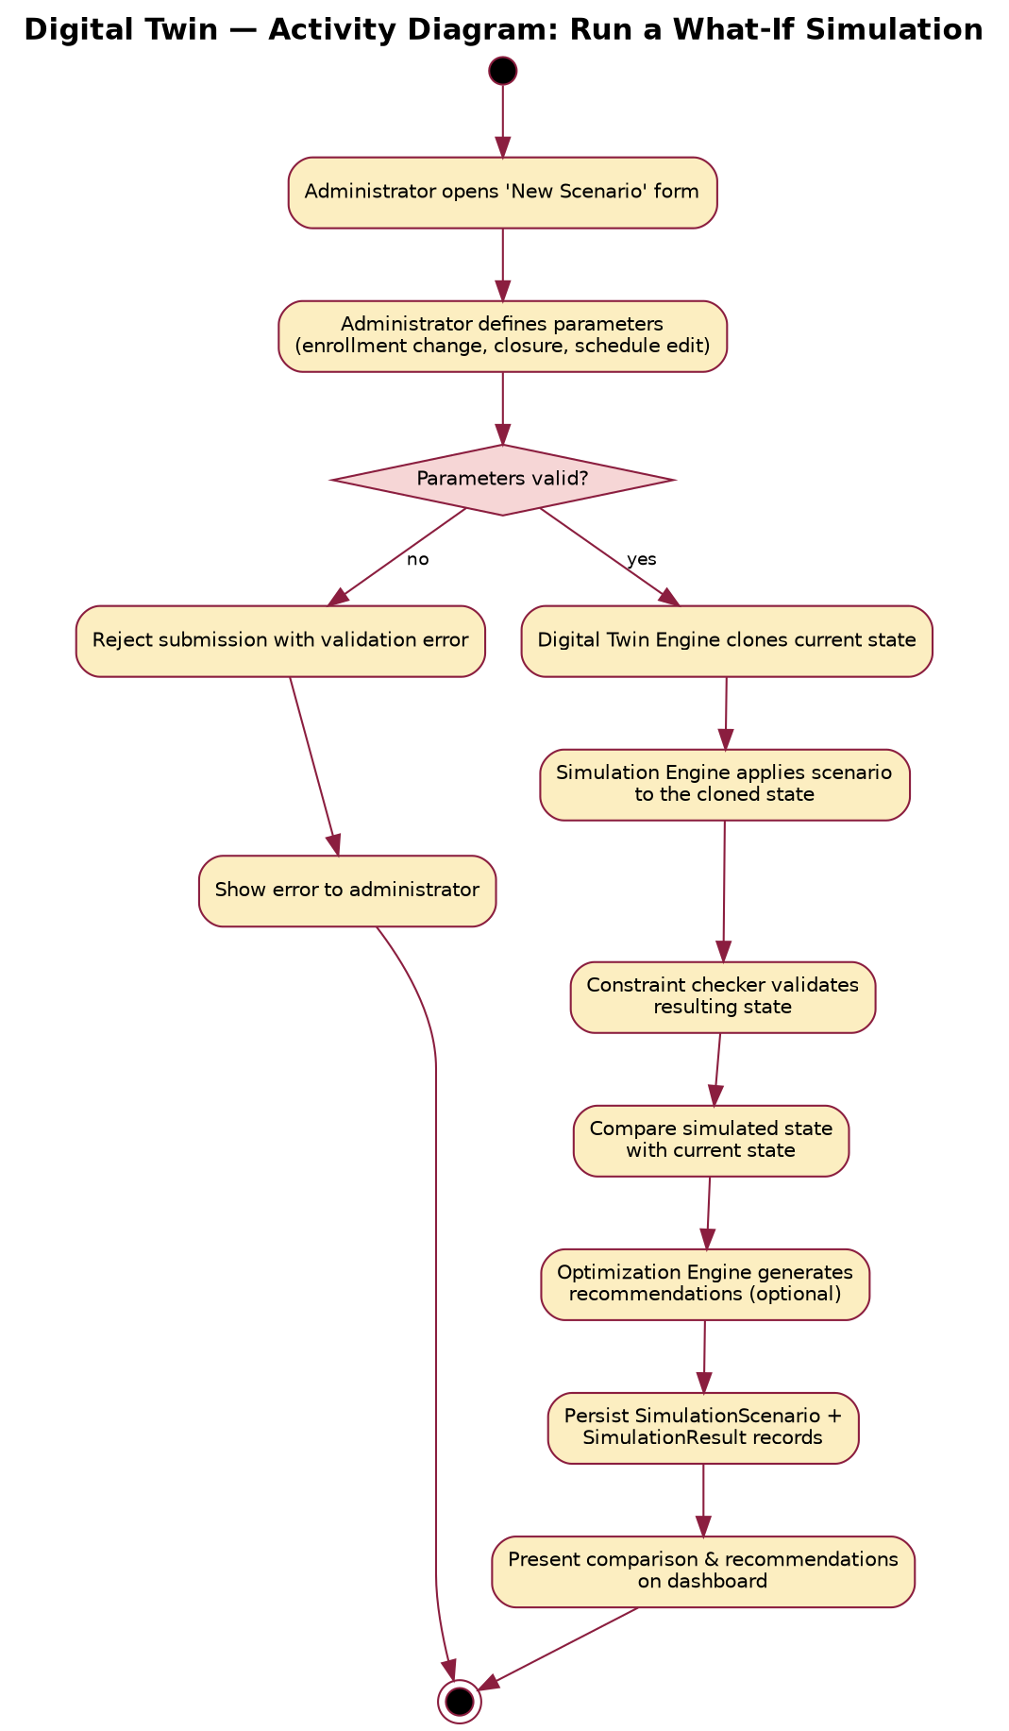
Screenshots

Slide 9
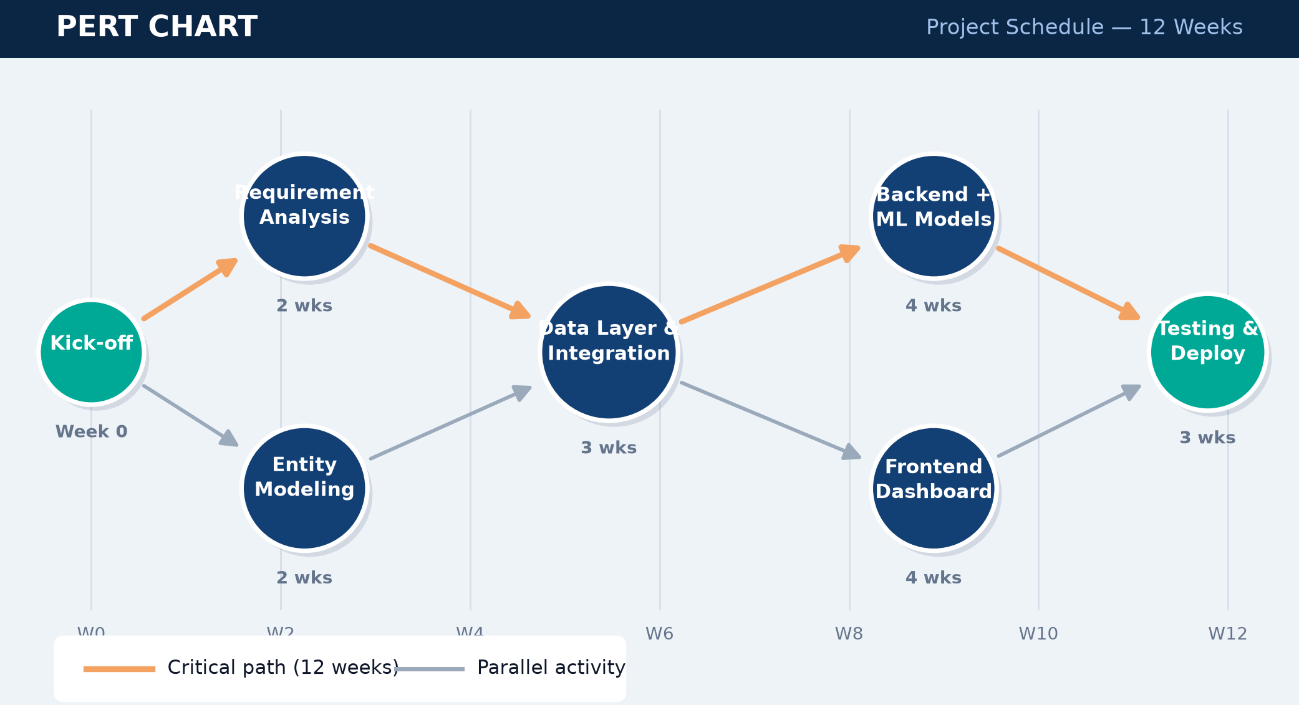
Pert Chart

Slide 10
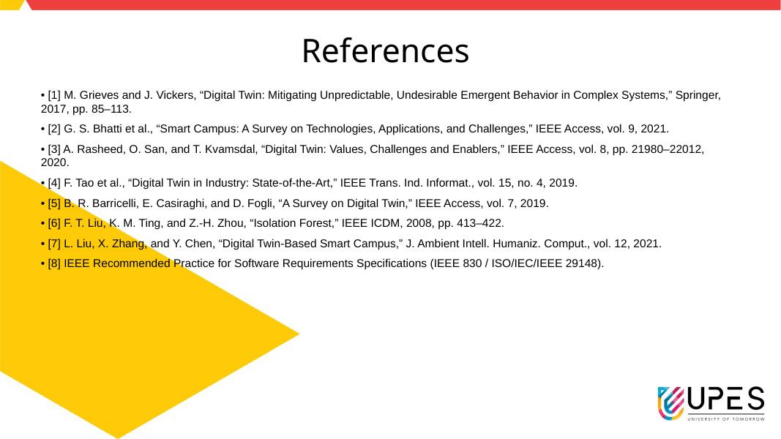
References

